Slide 1
BaaB: Bugs as a Backdoor
Shih-Kun Huang
Software Quality Lab
National Chiao Tung University
Hsinchu, Taiwan

Slide 2
Trusting Trust
If (a=1)
Reflections on Trusting Trust Ken Thompson
1984, Turing Award Lecture

Slide 3
Introduction
Constructing Symbolic Failure Models based on the software Crash
Producing Attacks through the Symbolic Model
Software Crash failures can be manipulated and Exploited
If Bugs are exploited and attacked, arbitrary code can be executed and a backdoor channel will be built
Bugs as a Backdoor

Slide 4
Finding bugs and backdoors
If a backdoor channel is built by embedding bugs in the system
Trojan horse identification will be reduced to the finding of the software bugs
Our work
Exploitable Crash detection
Automatic Exploitation (Attack input) Generation

Slide 5
CRAX: test if CRAsh eXploitable by Automatic Exploit Generation (CRAXing mplayer in minutes)
Reliability/Bug
Security/Vulnerability

Slide 6
CRAX is the second Binary AEG (Automatic Exploit Generator)
Microsoft’s !exploitable crash analyzer (plugged in many fuzzers) released in 2009
Heelan’s AEG and Concolic Methods for AEG proposed by different groups (including us) around 2008 and 2009
CMU’s AEG (and later Q) claimed to be the first end-to-end AEG needing source code, published in NDSS 2011
CMU’s MAYHEM claimed to be the first binary AEG, just published in May’s IEEE S&P 2012
Compared with AEG and MAYHEM, ours (CRAX) is simpler, more general, faster, and can be scaled to larger programs

Slide 7
Outline
Introduction
The need for exploit generation
Current methods
Our CRAX framework
Method
Implementation
Experiment results

Slide 8
The Need for Exploit Generation
Crash is inevitable in software
Need a way to judge exploitability
Too Many Crashes are to be fixed
Exploitable crashes without mitigations should be fixed first
Exploitable crashes with mitigations can be fixed later
Other crashes are prioritized in normal order
Exploit generation
A convincing way to prove exploitability

Slide 9
Motivation 2: Hacker’s Tool Chain
Bug Fuzzer
Crash
meta-fuzz, smart-fuzzer, zzuf, peach,taintscope,…
Crash detector or Failure Monitor
Taint Track
gdb,ollydbg,Pin, valgrind,CRED,Beagle,!exploitable,…
Exploit-code Generator ← missing link of the tool chain
Manually Efforts with Expertise
Heelan’s, AEG, Q, MAYHEM, and CRAX
Shell-code forger
Customized Payload
An Easier Botnet Builder
meta-sploit

Slide 10
Current Exploit Generation Method
Manual exploit generation
Time consuming
Require much skill and security knowledge
Automatic exploit generation
Platform dependent
Require source code (MAYHEM excluded)
Handle only limited kind of vulnerabilities

Slide 11
Our CRAX’s Framework
Based on the whole system emulation
Platform independent
Source is not needed
Generalized threat model
Can be applied to most of the vulnerabilities
Crash: Tainted Continuations
Exploitable: Symbolic Continuations

Slide 12
Outline
Introduction
Method
Overview
Code selection
Implementation
Experiment result

Slide 13
Overview of CRAX’s Framework
Built on S²E
A whole system symbolic execution engine
Exploit generation process
Explore crash path with the crash input
Only explore the crash path => concolic mode without forking another branch
Detect symbolic EIP (program counter)
Reason out exploit

Slide 14
Symbolic EIP (program counter)
Symbolic EIP and Tainted EIP
Tainted EIP: Only a bit, indicating the EIP is tainted
Symbolic EIP: several mega-bytes (of constraints)
Path Constraints: indicating the control flow to reach the crash site
Continuation Constraints: indicating the next “malicious progress” of exploits
Payload Constraints: indicating the code body of “malicious intents” to continue executions
Symbolic Continuations
While/for/if branch predicates/jmp buf/SEH/GOT/RET/
The process of Symbolic EIP detection is to Reconstruct a Symbolic Failure Model (after that, we can manipulate the Symbolic Model at will)

Slide 15
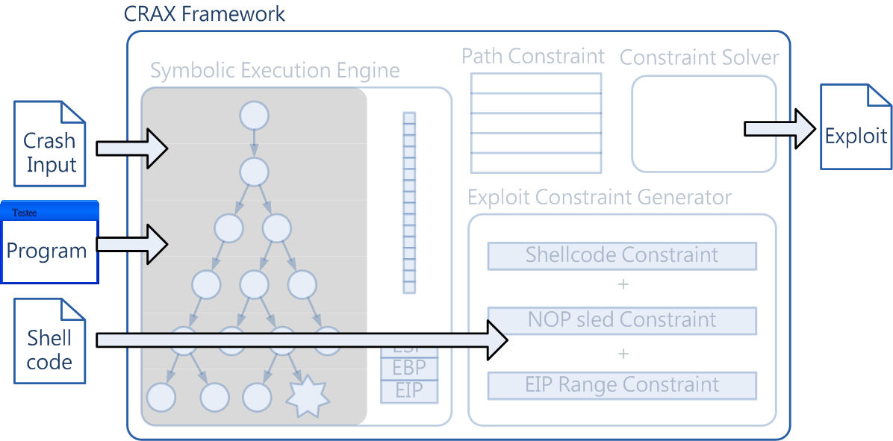
Exploit Generation Process
Objective: automatically generate an exploit for a given program binary and crash input

Slide 16
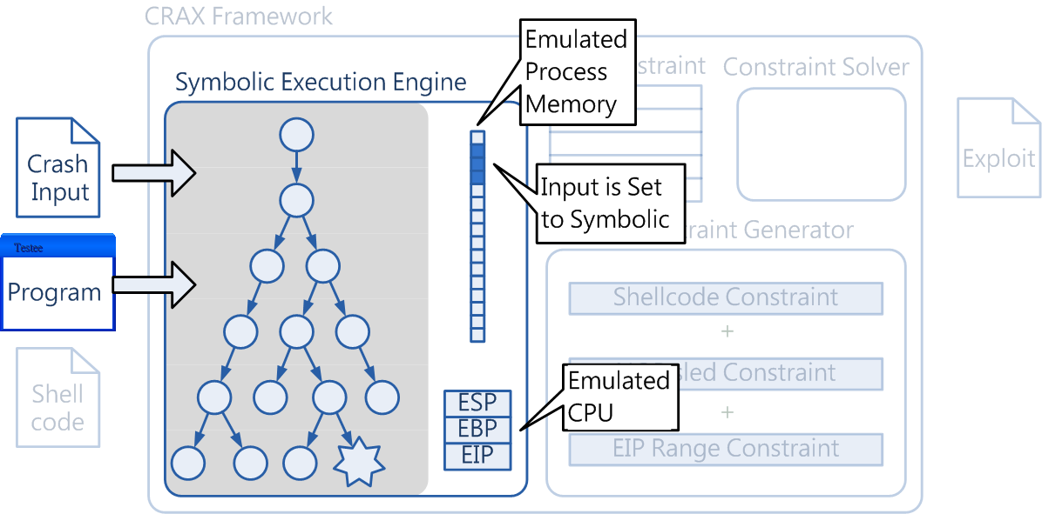
Exploit Generation Process
Initially, only input is symbolic

Slide 17
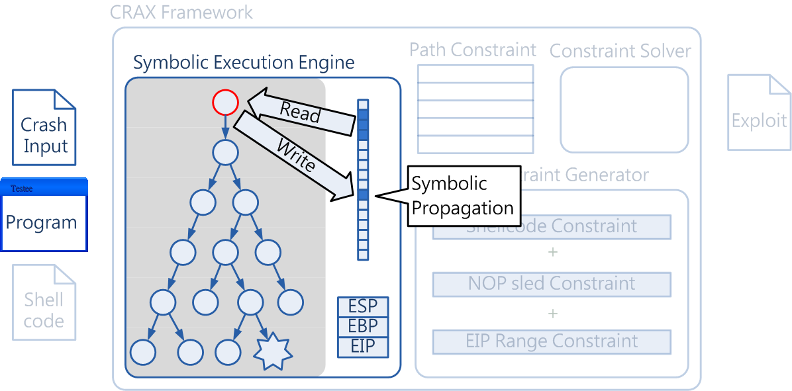
Exploit Generation Process
Symbolic data will propagate with program execution

Slide 18
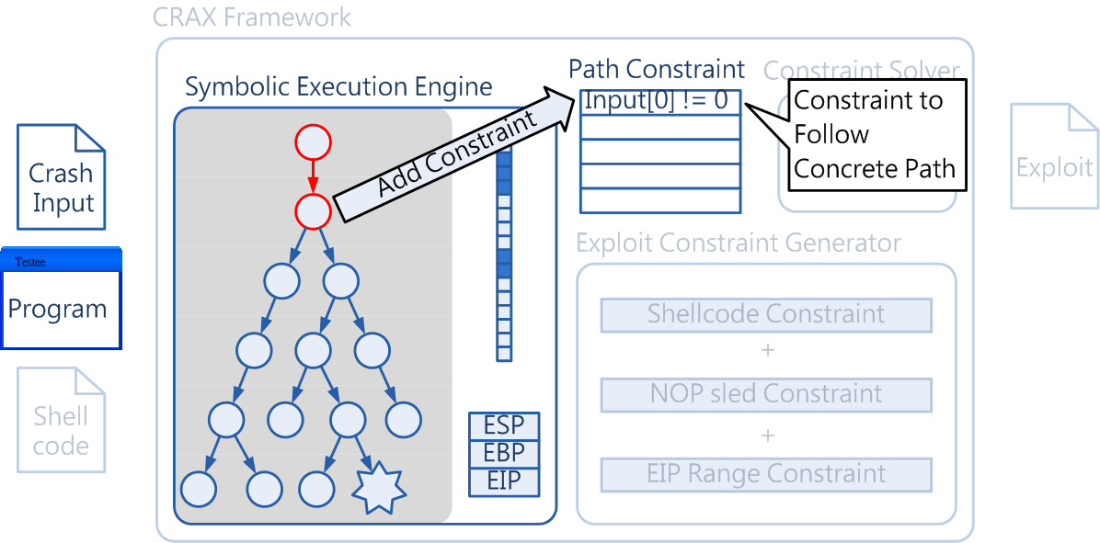
Exploit Generation Process
Also collect constraints that limit the program to follow the same path

Slide 19
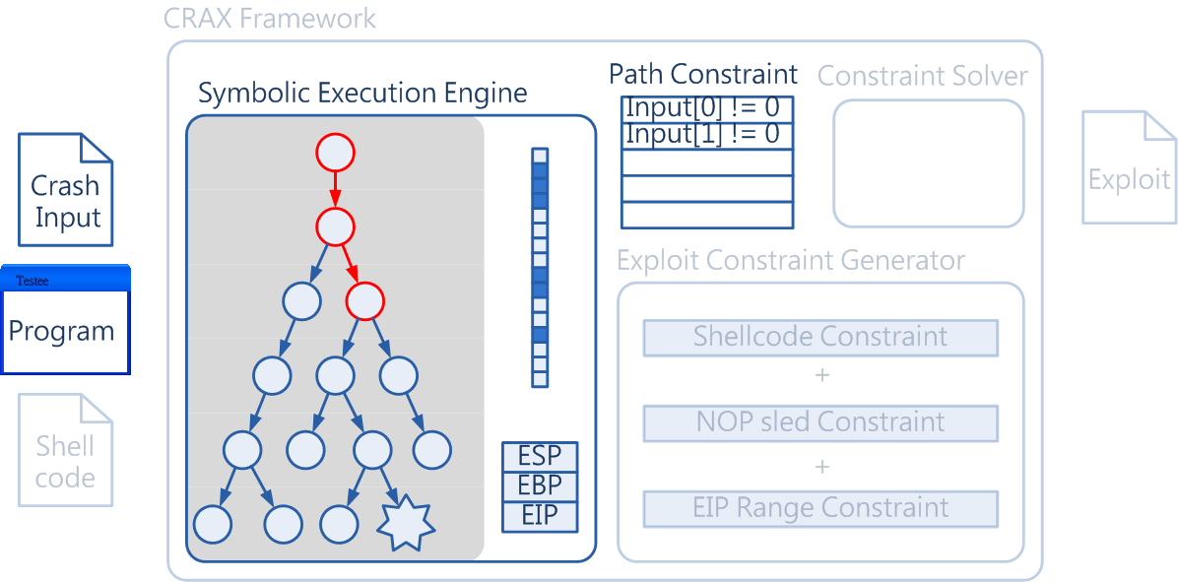
Exploit Generation Process
Collect path constraint & symbolic memory blocks…

Slide 20
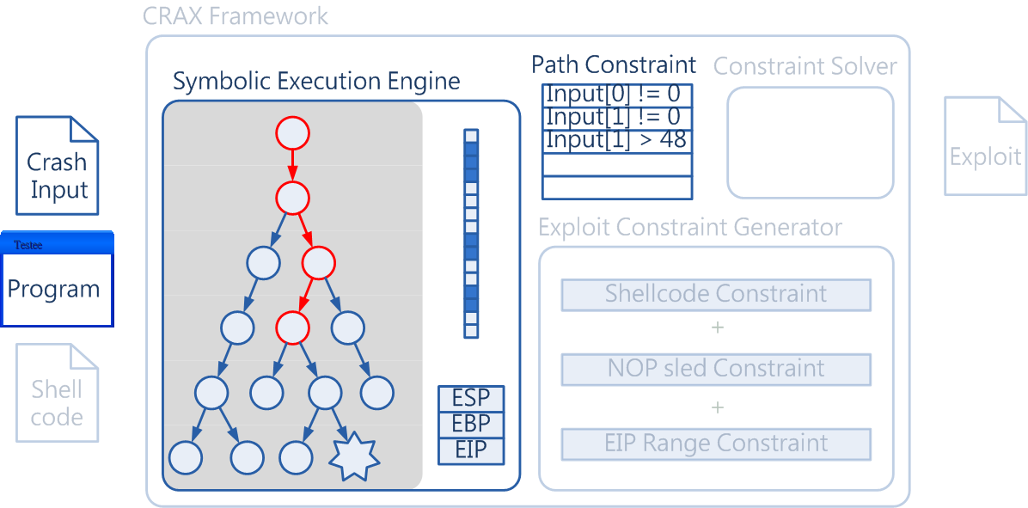
Exploit Generation Process

Slide 21
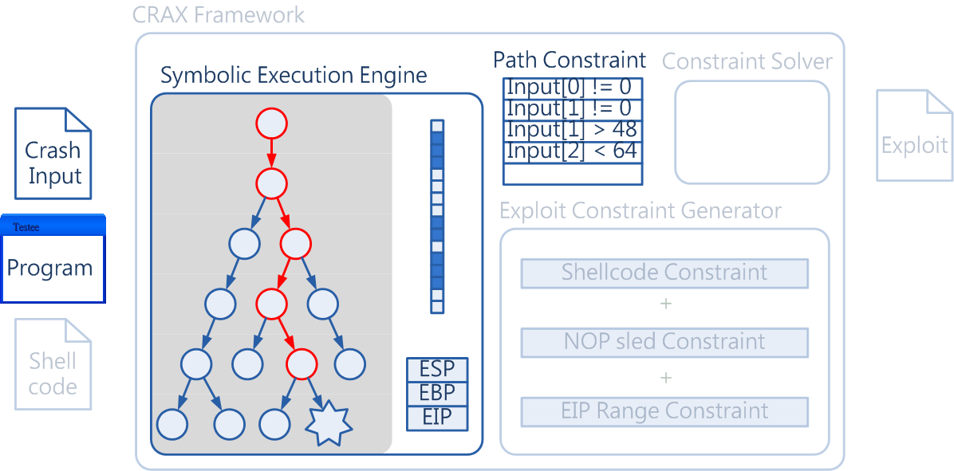
Exploit Generation Process

Slide 22
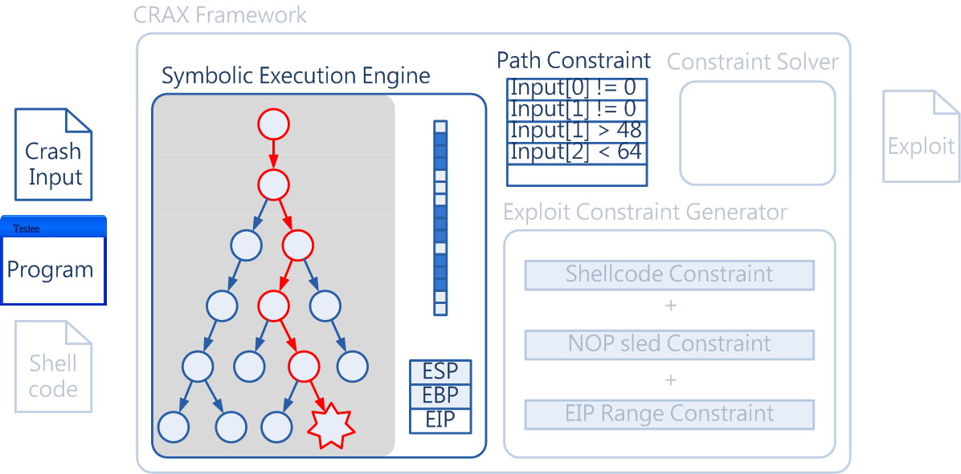
Exploit Generation Process

Slide 23
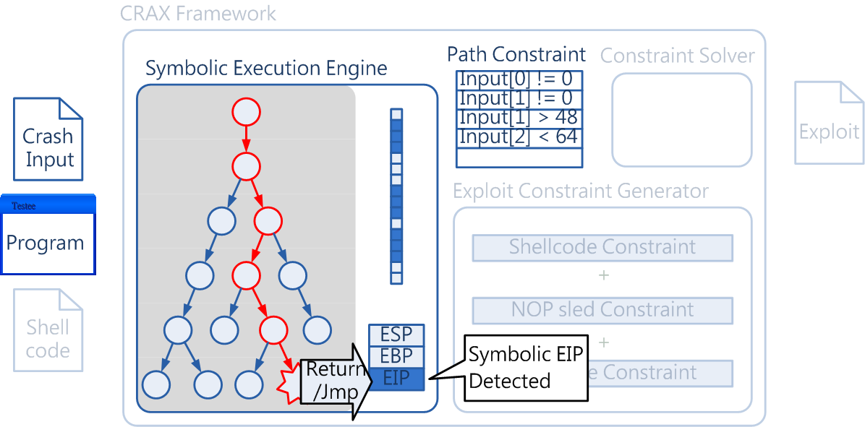
Exploit Generation Process
When a vulnerable return/call/jmp/exception is executed, symbolic EIP is detected

Slide 24
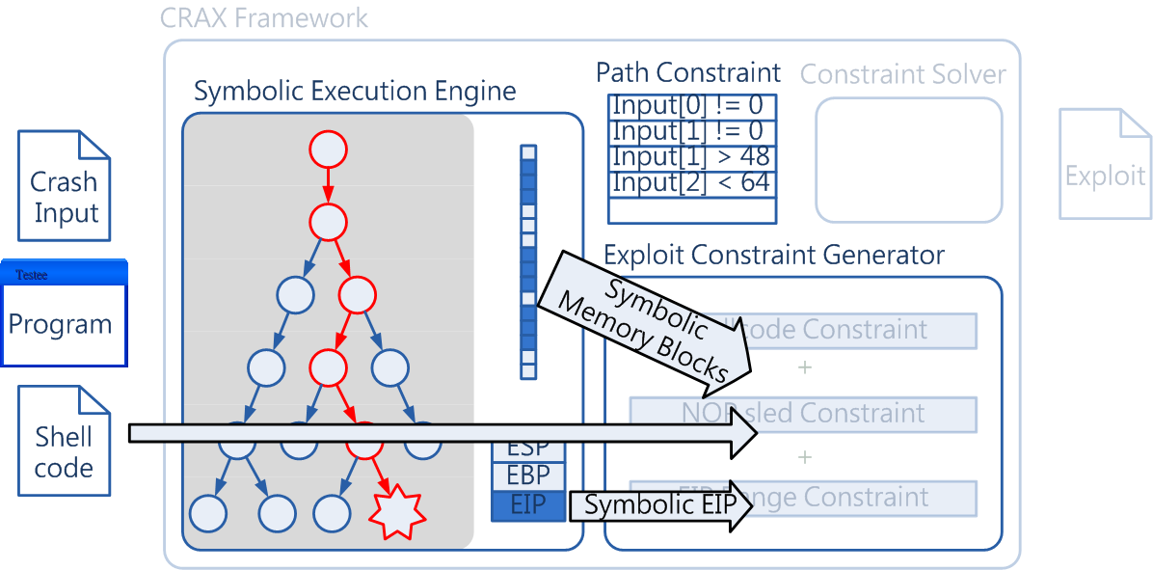
Exploit Generation Process
Using collected information to reason out an exploit

Slide 25
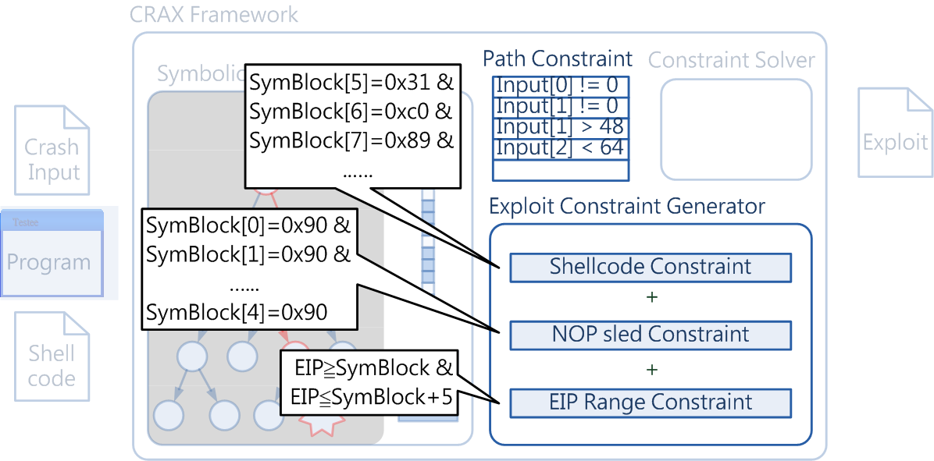
Exploit Generation Process
Constrain the content of a selected symbolic block to be our shellcode, and EIP to point to the block

Slide 26
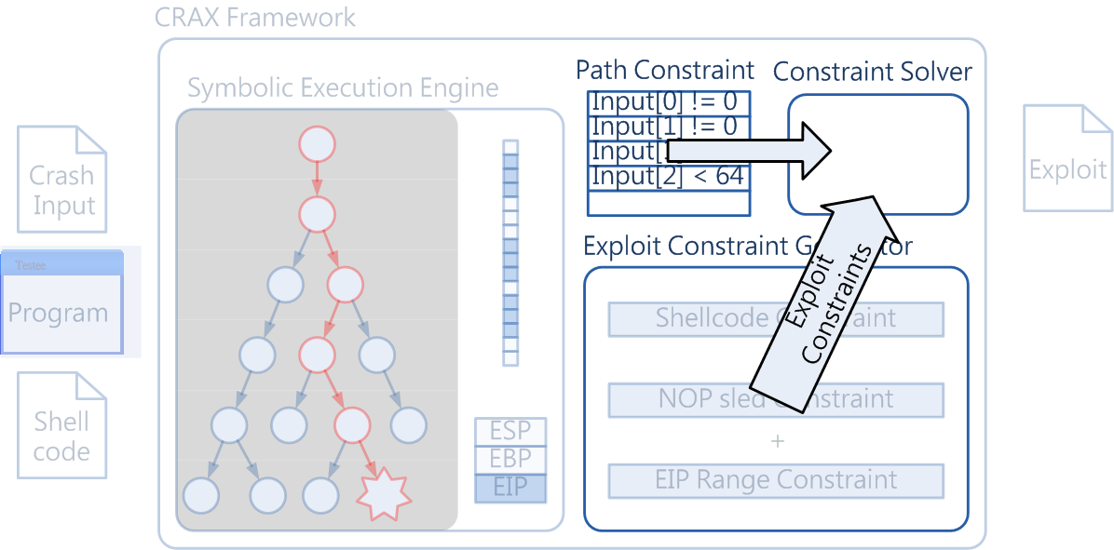
Exploit Generation Process
Query the solver to find a solution that satisfy both path constraint and exploit constraint

Slide 27
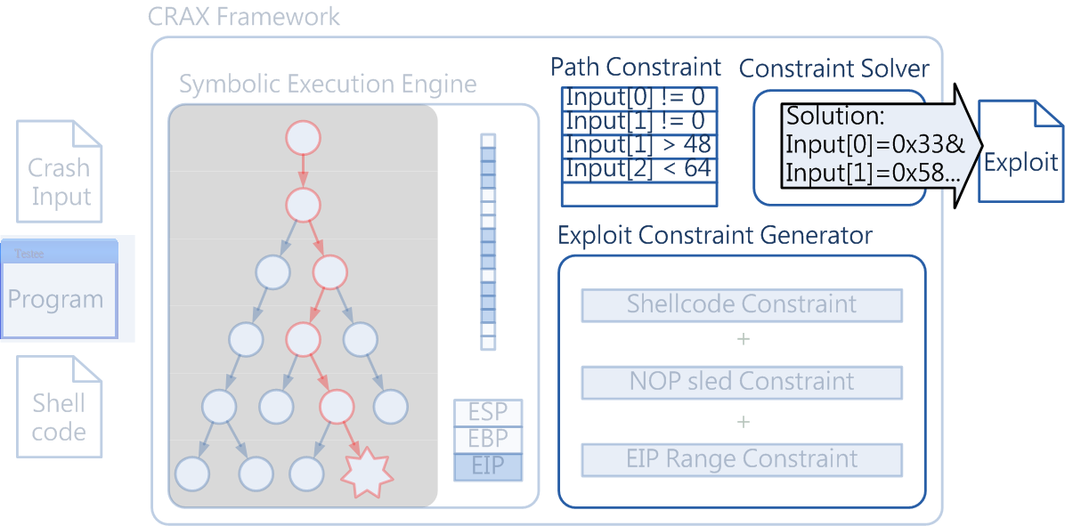
Exploit Generation Process
The solution is an exploit

Slide 28
Code Selection
Kernel & library code are huge and would add lots of constraints
Some kernel & library functions are irrelevant
Such as fopen() or perror()
Concretely execute them

Slide 29
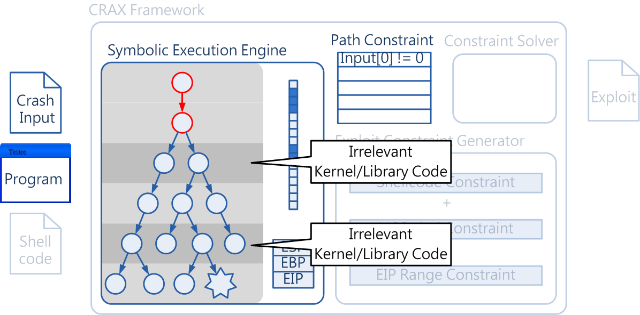
Code Selection

Slide 30
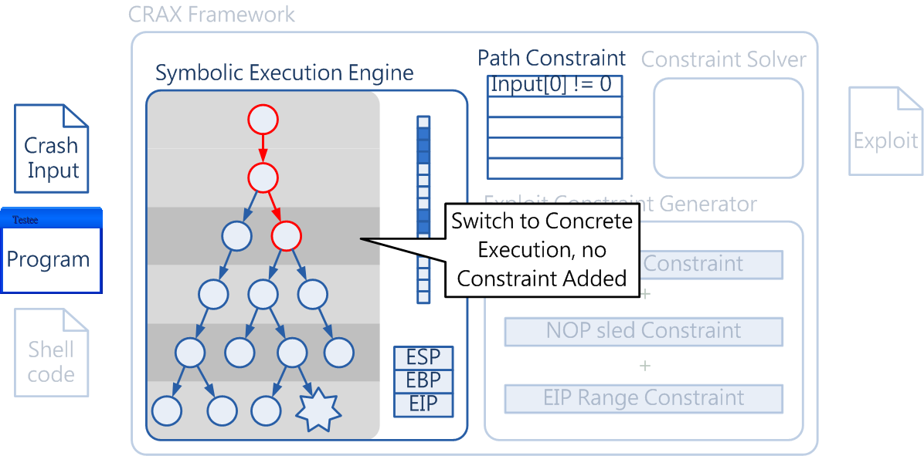
Code Selection

Slide 31
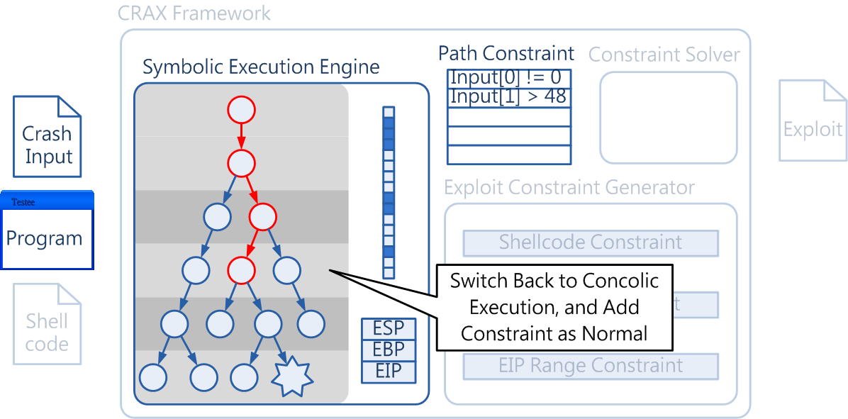
Code Selection

Slide 32
Outline
Introduction
Method
Implementation
Concolic mode
Code selection
Symbolic EIP detection
Exploit generation
Other types of exploit
Experiment result

Slide 33
Concolic Mode
Keep the concrete value in an extra constraint set
Concolic constraint
If branch condition is symbolic
We want to find its concrete value
Query the constraint solver with concolic constraint

Slide 34
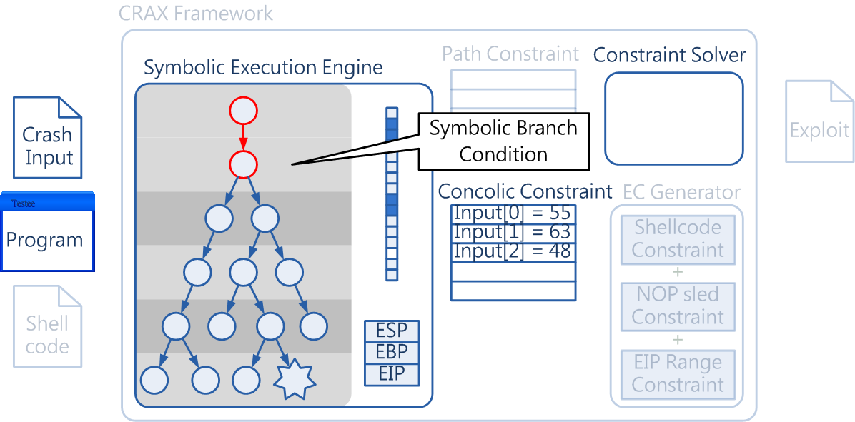
Concolic Mode

Slide 35
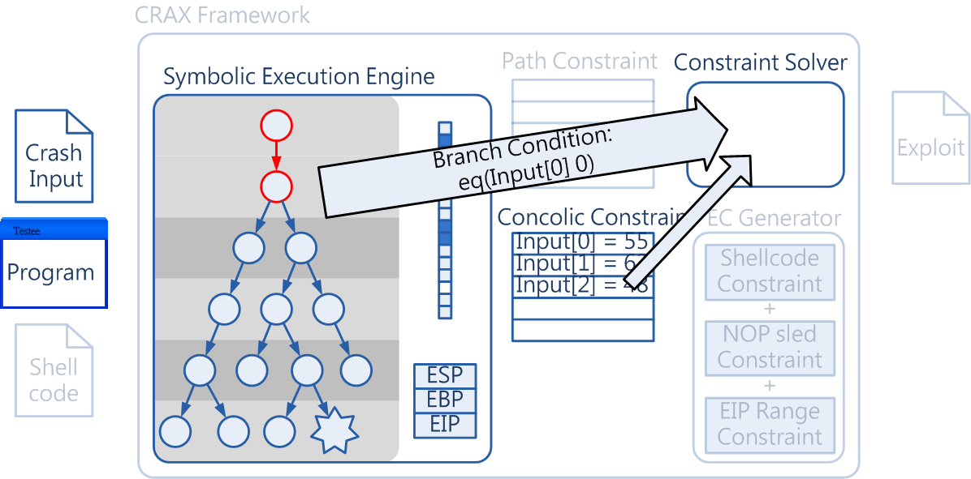
Concolic Mode
Query the solver to find the concrete value of branch condition

Slide 36
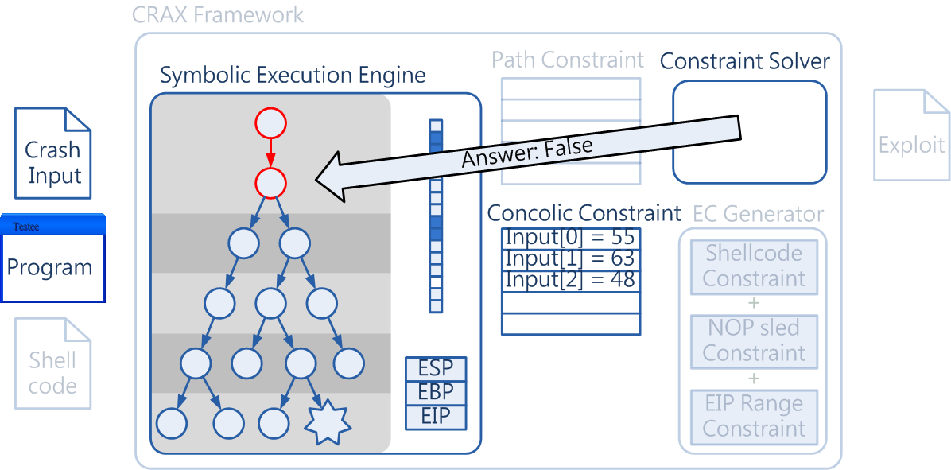
Concolic Mode

Slide 37
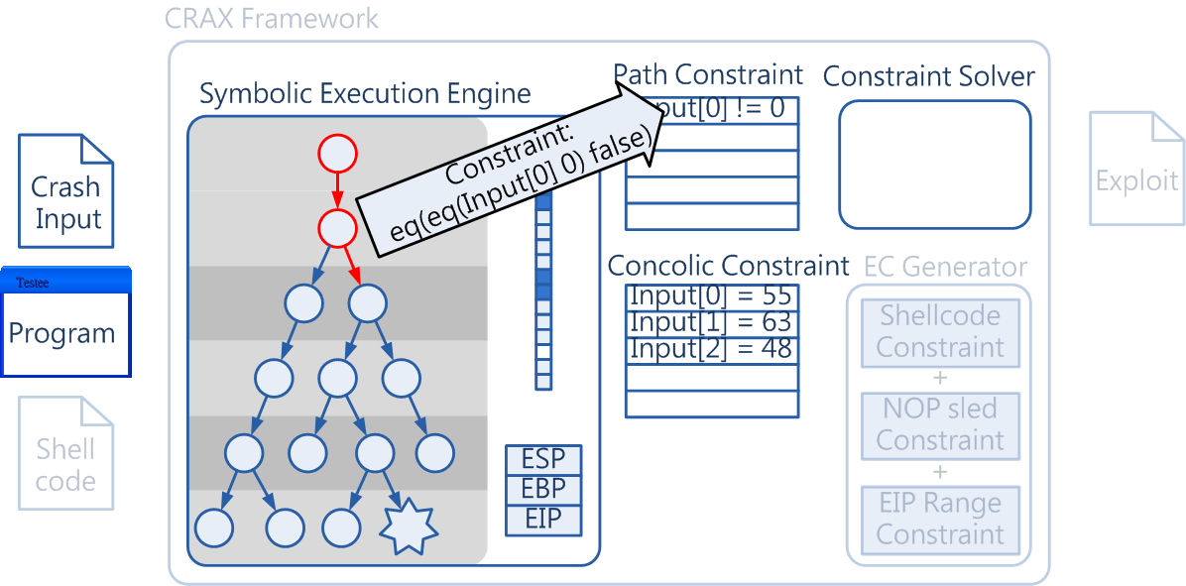
Concolic Mode
Follow the concrete path, and constrain branch condition to be the concrete value

Slide 38
Code Selection
Selective functionality of S²E
s2e_disable_symbolic_execution()
s2e_enable_symbolic_execution()
LD_PRELOAD environment variable in Linux
Intercept call to perror()/fopen()/…
Disable symbolic execution before enter libc
Enable symbolic execution after leave libc

Slide 39
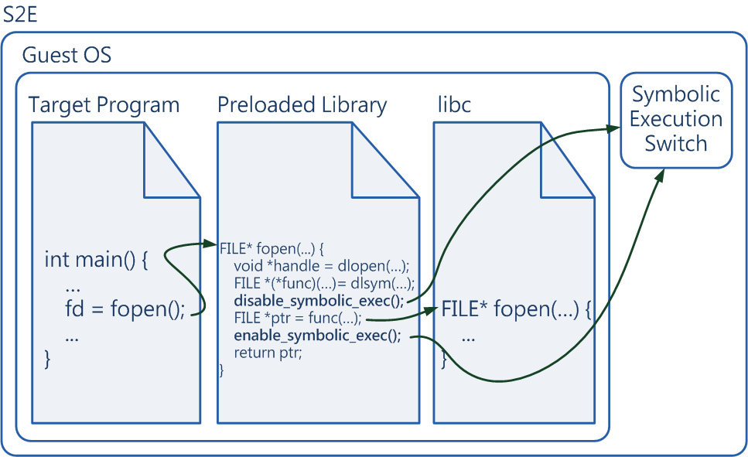
Code Selection

Slide 40
Symbolic EIP Detection
In the symbolic execution engine of S²E
State of emulated CPU is stored in CPUX86State structure
Guest code will be translated into llvm IR before symbolic executed
Access to CPU register will be translated into load/store IR to CPUX86State structure
Check executed store IR to see whether the target is EIP and value is symbolic

Slide 41
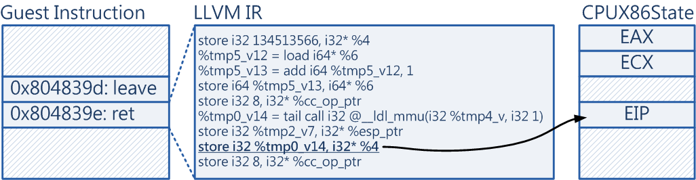
Symbolic EIP Detection

Slide 42
Exploit Generation
Finding symbolic memory blocks
Memory model in S²E
Search method
Shellcode injection
Determine the position of shellcode
Determine the length of nop sled
Determine EIP range

Slide 43
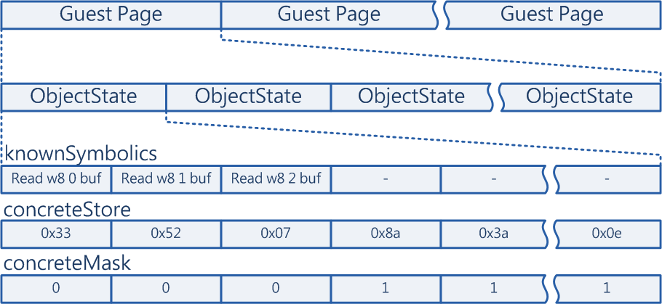
Memory Model in S²E
concreteMask is used to record which bytes of ObjectState is symbolic
Find blocks with consecutive 0s in concreteMask

Slide 44
Search Method
Search entire 2³² address space of guest process
Hierarchical search
Check the existence of all guest page
For each existing guest page, check which of its ObjectState contains symbolic data
For each ObjectState that contains symbolic data, search consecutive symbolic blocks in it

Slide 45
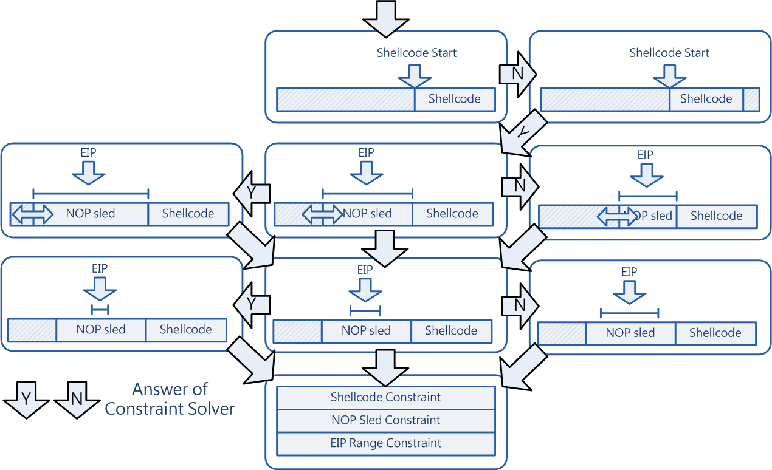
Shellcode Injection

Slide 46
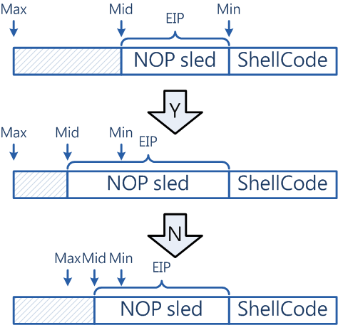
Determine NOP Sled Length
Binary search like algorithm
Ensure
EIP can point to NOP range
NOP can fill the range

Slide 47
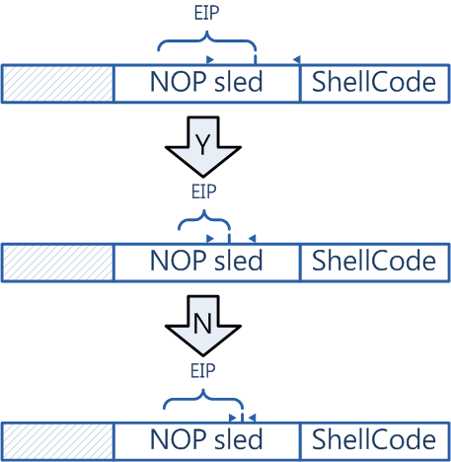
Determine EIP Range
Binary search like algorithm
Try to point EIP to the middle of NOP sled

Slide 48
Other Optimizations
Fast Construction of the Symbolic Failure Model
Fast Concolic (input constraint, branch condition, and path constraint reductions along with the failure path) by selective symbolic execution
Input Selections (adaptive symbolic Input)
Most of the benchmark used by AEG and MAYHEM can be resolved by dividing inputs into smaller symbolic blocks
An iterative and still automatic process

Slide 49
Outline
Introduction
Method
Implementation
Experiment results
CRAX results
Comparisons with AEG benchmarks
Comparisons with MAYHEM benchmarks
Results of larger programs

Slide 50
CRAX Results (model building)
Program | Input source | Input Length | Advisory ID | CRAX Time | CRAX Time (fast concolic)
aeon | Env. Var. | 550 | CVE-2005-1019 | 298.12
iwconfig | Arguments | 85 | BID-8901 | 4.21
glftpd | Arguments | 300 | OSVDB-16373 | 50.07
ncompress | Arguments | 1050 | CVE-2001-1413 | 2000.41
htget | Arguments | 276 | CVE-2004-0852 | 146.72
htget | Env. Var. | 180 | CMU AEG 0-day
expect | Env. Var.(HOME) | 300 | OSVDB-60979 | 172.50
expect | Env. Var.(DOTDIR) | 300 | CMU AEG 0-day
rsync | Env. Var. | 201 | CVE-2004-2093 | 210.53
acon | Env. Var. | 1300 | CVE-2008-1994 | 3782.50
gif2png | Arguments | 1080 | CVE-2009-5018 | 12254.87
hsolink | Arguments | 1050 | CVE-2010-2930 | 2422.07
exim | Arguments | 304 | EDB-ID#796
aspell | Stdin | 300 | CVE-2004-0548
xserver | Socket | 104 | CVE-2007-3957
xmail | Stdin | 307 | CVE-2005-2943

Slide 51
CRAX Results (model building)
Program | Input source | Input Length | Advisory ID | CRAX Time | CRAX Time (fast concolic)
aeon | Env. Var. | 550 | CVE-2005-1019 | 298.12 | 19.67 (15.1x)
iwconfig | Arguments | 85 | BID-8901 | 4.21 | 2.68 (1.57x)
glftpd | Arguments | 300 | OSVDB-16373 | 50.07 | 4.71 (10.63x)
ncompress | Arguments | 1050 | CVE-2001-1413 | 2000.41 | 53.79(37.18x)
htget | Arguments | 276 | CVE-2004-0852 | 146.72 | 27.19(5.39)
htget | Env. Var. | 180 | CMU AEG 0-day
expect | Env. Var.(HOME) | 300 | OSVDB-60979 | 172.50 | 23.51(7.33x)
expect | Env. Var.(DOTDIR) | 300 | CMU AEG 0-day
rsync | Env. Var. | 201 | CVE-2004-2093 | 210.53 | 7.75(27.1x)
acon | Env. Var. | 1300 | CVE-2008-1994 | 3782.50 | 68.86(54.93x)
gif2png | Arguments | 1080 | CVE-2009-5018 | 12254.87 | 89.43(25.21x)
hsolink | Arguments | 1050 | CVE-2010-2930 | 2422.07 | 47.47(51.02x)
exim | Arguments | 304 | EDB-ID#796
aspell | Stdin | 300 | CVE-2004-0548
xserver | Socket | 104 | CVE-2007-3957
xmail | Stdin | 307 | CVE-2005-2943

Slide 52
CRAX Results (fast concolic)
Program | Input source | Input Length | Advisory ID | CRAX Time (fast concolic) | CRAX Time (Adaptive)
aeon | Env. Var. | 550 | CVE-2005-1019 | 32.0
iwconfig | Arguments | 85 | BID-8901 | 3.6
glftpd | Arguments | 300 | OSVDB-16373 | 8.0
ncompress | Arguments | 1050 | CVE-2001-1413 | 99.4
htget | Arguments | 276 | CVE-2004-0852 | 35.5
htget | Env. Var. | 180 | CMU AEG 0-day | 5.1
expect | Env. Var.(HOME) | 300 | OSVDB-60979 | 29.4
expect | Env. Var.(DOTDIR) | 300 | CMU AEG 0-day | 29.3
rsync | Env. Var. | 201 | CVE-2004-2093 | 9.9
acon | Env. Var. | 1300 | CVE-2008-1994 | 32.0
gif2png | Arguments | 1080 | CVE-2009-5018 | 154.7
hsolink | Arguments | 1050 | CVE-2010-2930 | 103.9
exim | Arguments | 304 | EDB-ID#796 | 122.3
aspell | Stdin | 300 | CVE-2004-0548 | 14.5
xserver | Socket | 104 | CVE-2007-3957 | 14.4
xmail | Stdin | 307 | CVE-2005-2943 | 371.7

Slide 53
CRAX Results (adaptive input)
Program | Input source | Input Length | Advisory ID | CRAX Time | CRAX Time (Adaptive)
aeon | Env. Var. | 550 | CVE-2005-1019 | 32.0 | 2.6
iwconfig | Arguments | 85 | BID-8901 | 3.6 | 0.7
glftpd | Arguments | 300 | OSVDB-16373 | 8.0 | 0.5
ncompress | Arguments | 1050 | CVE-2001-1413 | 99.4 | 0.7
htget | Arguments | 276 | CVE-2004-0852 | 35.5 | 2.9
htget | Env. Var. | 180 | CMU AEG 0-day | 5.1 | 1.17
expect | Env. Var.(HOME) | 300 | OSVDB-60979 | 29.4 | 2.7
expect | Env. Var.(DOTDIR) | 300 | CMU AEG 0-day | 29.3 | 3.56
rsync | Env. Var. | 201 | CVE-2004-2093 | 9.9 | 2.7
acon | Env. Var. | 1300 | CVE-2008-1994 | 32.0 | 2.7
gif2png | Arguments | 1080 | CVE-2009-5018 | 154.7 | 1.69
hsolink | Arguments | 1050 | CVE-2010-2930 | 103.9 | 2.4
exim | Arguments | 304 | EDB-ID#796 | 122.3 | 4.3
aspell | Stdin | 300 | CVE-2004-0548 | 14.5 | 1.7
xserver | Socket | 104 | CVE-2007-3957 | 14.4 | 2.5
xmail | Stdin | 307 | CVE-2005-2943 | 371.7 | 171.0

Slide 54
CRAX Results
Program | Input source | Input Length | Advisory ID | CRAX Time | CRAX Time (Adaptive)
aeon | Env. Var. | 550 | CVE-2005-1019 | 32.0 | 2.6
iwconfig | Arguments | 85 | BID-8901 | 3.6 | 0.7
glftpd | Arguments | 300 | OSVDB-16373 | 8.0 | 0.5
ncompress | Arguments | 1050 | CVE-2001-1413 | 99.4 | 0.7
htget | Arguments | 276 | CVE-2004-0852 | 35.5 | 2.9
htget | Env. Var. | 180 | CMU AEG 0-day | 5.1 | 1.17
expect | Env. Var.(HOME) | 300 | OSVDB-60979 | 29.4 | 2.7
expect | Env. Var.(DOTDIR) | 300 | CMU AEG 0-day | 29.3 | 3.56
rsync | Env. Var. | 201 | CVE-2004-2093 | 9.9 | 2.7
acon | Env. Var. | 1300 | CVE-2008-1994 | 32.0 | 2.7
gif2png | Arguments | 1080 | CVE-2009-5018 | 154.7 | 1.69
hsolink | Arguments | 1050 | CVE-2010-2930 | 103.9 | 2.4
exim | Arguments | 304 | EDB-ID#796 | 122.3 | 4.3
aspell | Stdin | 300 | CVE-2004-0548 | 14.5 | 1.7
xserver | Socket | 104 | CVE-2007-3957 | 14.4 | 2.5
xmail | Stdin | 307 | CVE-2005-2943 | 371.7 | 171.0

Slide 55
Comparisons with AEG Benchmarks
Program | Input source | Input Length | AEG Time Core i7, 3.4G | CRAX Time Core 2, 2.66G | CRAX Time (Adaptive) | Speedup
aeon | Env. Var. | 550 |  | 32.0 | 2.6
iwconfig | Arguments | 85 |  | 3.6 | 0.7
glftpd | Arguments | 300 |  | 8.0 | 0.5
ncompress | Arguments | 1050 |  | 99.4 | 0.7
htget | Arguments | 276 |  | 35.5 | 2.9
htget | Env. Var. | 180 |  | 5.1 | 1.17
expect | Env. Var.(HOME) | 300 |  | 29.4 | 2.7
expect | Env. Var.(DOTDIR) | 300 |  | 29.3 | 3.56
rsync | Env. Var. | 201 |  | 9.9 | 2.7
acon | Env. Var. | 1300 |  | 32.0 | 2.7
gif2png | Arguments | 1080 |  | 154.7 | 1.69
hsolink | Arguments | 1050 |  | 103.9 | 2.4
exim | Arguments | 304 |  | 122.3 | 4.3
aspell | Stdin | 300 |  | 14.5 | 1.7
xserver | Socket | 104 |  | 14.4 | 2.5
xmail | Stdin | 307 |  | 371.7 | 171.0

Slide 56
Comparisons with AEG Benchmarks
Program | Input source | Input Length | AEG Time Core i7, 3.4G | CRAX Time Core 2, 2.66G | CRAX Time (Adaptive) | Speedup
aeon | Env. Var. | 550 | 3.8 | 32.0 | 2.6
iwconfig | Arguments | 85 | 1.5 | 3.6 | 0.7
glftpd | Arguments | 300 | 2.3 | 8.0 | 0.5
ncompress | Arguments | 1050 | 12.3 | 99.4 | 0.7
htget | Arguments | 276 | 57.2 | 35.5 | 2.9
htget | Env. Var. | 180 | 1.2 | 5.1 | 1.17
expect | Env. Var.(HOME) | 300 | 187.6 | 29.4 | 2.7
expect | Env. Var.(DOTDIR) | 300 | 186.7 | 29.3 | 3.56
rsync | Env. Var. | 201 | 19.7 | 9.9 | 2.7
acon | Env. Var. | 1300 |  | 32.0 | 2.7
gif2png | Arguments | 1080 |  | 154.7 | 1.69
hsolink | Arguments | 1050 |  | 103.9 | 2.4
exim | Arguments | 304 | 33.8 | 122.3 | 4.3
aspell | Stdin | 300 | 15.2 | 14.5 | 1.7
xserver | Socket | 104 | 31.9 | 14.4 | 2.5
xmail | Stdin | 307 | 1276.0 | 371.7 | 171.0

Slide 57
Comparisons with AEG Benchmarks
Program | Input source | Input Length | AEG Time | CRAX Time Core 2, 2.66G | CRAX Time (Adaptive) | Speedup
aeon | Env. Var. | 550 | 3.8 | 32.0 | 2.6 | 1.5x
iwconfig | Arguments | 85 | 1.5 | 3.6 | 0.7 | 2.1x
glftpd | Arguments | 300 | 2.3 | 8.0 | 0.5 | 4.6x
ncompress | Arguments | 1050 | 12.3 | 99.4 | 0.7 | 17.6x
htget | Arguments | 276 | 57.2 | 35.5 | 2.9 | 19.7x
htget | Env. Var. | 180 | 1.2 | 5.1 | 1.17 | 1.0x
expect | Env. Var.(HOME) | 300 | 187.6 | 29.4 | 2.7 | 69.5x
expect | Env. Var.(DOTDIR) | 300 | 186.7 | 29.3 | 3.56 | 52.44x
rsync | Env. Var. | 201 | 19.7 | 9.9 | 2.7 | 7.3x
acon | Env. Var. | 1300 |  | 32.0 | 2.7
gif2png | Arguments | 1080 |  | 154.7 | 1.69
hsolink | Arguments | 1050 |  | 103.9 | 2.4
exim | Arguments | 304 | 33.8 | 122.3 | 4.3 | 7.9x
aspell | Stdin | 300 | 15.2 | 14.5 | 1.7 | 8.9x
xserver | Socket | 104 | 31.9 | 14.4 | 2.5 | 12.8x
xmail | Stdin | 307 | 1276.0 | 371.7 | 171.0 | 7.5x

Slide 58
Comparisons with MAYHEM Benchmarks (Linux)
Program | Input source | Input Length | Mayhem Time Core i7, 3.4G | CRAX Time Core 2, 2.66G | CRAX Time (Adaptive)
Aeon | Env. Var. | 550 | 10 | 32.0 | 2.6
Aspell | stdin | 750 | 82 | 14.5 | 1.7
Glftpd | Arguments | 300 | 4 | 8.0 | 0.5
Htget | Env. Var. | 350 | 7 | 5.1 | 1.17
Iwconfig | Arg. | 400 | 2 | 3.6 | 0.7
nCompress | Arg. | 1400 | 11 | 99.4 | 0.7
Rsync | Env.Var. | 100 | 8 | 9.9 | 2.7
Mbse-bbs | Env. Var. | 4200 | 362.0 | 784.5 | 26.9
PSUtils | Arguments | 300 | 46.0 | 122.6 | 25.4
Htpasswd | Arguments | 400 | 4.0 | 5.2 | 0.4
Squirrel Mail | Arguments | 150 | 2 | 5.6 | 0.9

Slide 59
Comparisons with MAYHEM Benchmarks (Linux)
Program | Input source | Input Length | Mayhem Time Core i7, 3.4G | CRAX Time Core 2, 2.66G | CRAX Time (Adaptive)
Aeon | Env. Var. | 550 | 10 | 32.0 | 2.6 (38.4x)
Aspell | stdin | 750 | 82 | 14.5 | 1.7 (48.2x)
Glftpd | Arguments | 300 | 4 | 8.0 | 0.5 (8x)
Htget | Env. Var. | 350 | 7 | 5.1 | 1.17(5.9x)
Iwconfig | Arg. | 400 | 2 | 3.6 | 0.7(2.9x)
nCompress | Arg. | 1400 | 11 | 99.4 | 0.7(15.7x)
Rsync | Env.Var. | 100 | 8 | 9.9 | 2.7(3x)
Mbse-bbs | Env. Var. | 4200 | 362.0 | 784.5 | 26.9(13.4x)
PSUtils | Arguments | 300 | 46.0 | 122.6 | 25.4(1.8x)
Htpasswd | Arguments | 400 | 4.0 | 5.2 | 0.4(10x)
Squirrel Mail | Arguments | 150 | 2 | 5.6 | 0.9(2.2x)

Slide 60
Comparisons with MAYHEM Benchmarks (windows)
Program | Input source | Input Length | Mayhem Time Core i7, 3.4G | CRAX Time Core 2, 2.66G | CRAX Time (Adaptive)
Coolplayer | File | 210 | 164.0 | 140.7
Distiny | File | 2100 | 963.0 | 60.8
Dizzy | Arguments | 519 | 13260.0 | 313.0 (Only Explore)
GAlan | File | 1500 | 831.0 | 26.1
GSPlayer | File | 400 | 120.0 | 33.3

Slide 61
Comparisons with MAYHEM Benchmarks (windows)
Program | Input source | Input Length | Mayhem Time Core i7, 3.4G | CRAX Time Core 2, 2.66G | CRAX Time (Adaptive)
Coolplayer | File | 210 | 164.0 | 140.7 (1.4x)
Distiny | File | 2100 | 963.0 | 60.8 (15.8x)
Dizzy | Arguments | 519 | 13260.0 | 313.0 (Only Explore)
GAlan | File | 1500 | 831.0 | 26.1 (31x)
GSPlayer | File | 400 | 120.0 | 33.3 (36x)

Slide 62
Results of Larger Programs
Program | Input source | Input Length | Explore Time | Exploit Gen. Time | Explore Time (Adaptive) | Exploit Gen. Time (Adaptive)
Unrar | Arguments | 5000 | 1388.5 | 2569.8
Mplayer (Linux) | File | 145 | 145.8 | 151.2
Mplayer (Windows) | File | 5568 | 1713.8 | 2939.4
Foxit Reader | File | 10503 | 5211.1 | 10094.2

Slide 63
Results of Craxing Larger Programs
Program | Input source | Input Length | Explore Time | Exploit Gen. Time | Explore Time (Adaptive) | Exploit Gen. Time (Adaptive)
Unrar | Arguments | 5000 | 1388.5 | 2569.8 | 11.7 | 1.8
Mplayer (Linux) | File | 145 | 145.8 | 151.2 | 3.3 | 0.3
Mplayer (Windows) | File | 5568 | 1713.8 | 2939.4
Foxit Reader | File | 10503 | 5211.1 | 10094.2
Program | Constraint Size (Bytes) | Symbolic-exec Instructions
Unrar | 2.91M | 1177301
Mplayer (Windows) | 3.89M | 1146887
Foxit Reader | 3.91M | 1825260

Slide 64
Comparisons of AEG Features
System | Heelan’s (Sep 2009) | APEG (May 2008) | AEG (Feb 2011) | MAYHEM (May 2012) | CRAX (June 2012)
Exploit-gen | Yes | No | Yes | Yes | Yes
End-to-end | No | No | Yes | Yes | Yes
Source/Binary | Source | Binary | Source | Binary | Binary
Instrument | PIN | QEMU |  | PIN | QEMU
Symbolic Environment | No | - | incomplete 8000 LOC | Incomplete 10000 LOC | 6 models of S2E all environment, 100 LOC
Symbolic Memory (Concrete) | - | - | No (abstract) | Yes (implement with efforts) | Yes (built in S2E, small efforts)
Selected Symbolic Execution |  |  |  | Partial | Selected code/path/input
Performance |  |  | fast | slow | faster (larger and much faster, x10 faster)
Scale | XBMC |  | xmail | Dizzy | Mplayer/Foxit pdf reader
Platforms | Linux |  | Linux | Linux/windows | Linux/Windows/Web
Applicability |  |  | process | process | process/system/kernel

Slide 65
Comparisons of AEG Features
System | Heelan’s (Sep 2009) | APEG (May 2008) | AEG (Feb 2011) | MAYHEM (May 2012) | CRAX (June 2012)
Exploit-gen | Yes | No | Yes | Yes | Yes
End-to-end | No | No | Yes | Yes | Yes
Source/Binary | Source | Binary | Source | Binary | Binary
Instrument | PIN | QEMU |  | PIN | QEMU
Symbolic Environment | No | - | incomplete 8000 LOC | Incomplete 10000 LOC | 6 models of S2E all environment, 100 LOC
Symbolic Memory (Concrete) | - | - | No (abstract) | Yes (implement with efforts) | Yes (built in S2E, small efforts)
Selected Symbolic Execution |  |  |  | Partial | Selected code/path/input
Performance |  |  | fast | slow | faster (larger and much faster, x10 faster)
Scale | XBMC |  | xmail | Dizzy | Mplayer/Foxit pdf reader
Platforms | Linux |  | Linux | Linux/windows | Linux/Windows/Web
Applicability |  |  | process | process | process/system/kernel

Slide 66
Comparisons of AEG Features
System | Heelan’s (Sep 2009) | APEG (May 2008) | AEG (Feb 2011) | MAYHEM (May 2012) | CRAX (June 2012)
Exploit-gen | Yes | No | Yes | Yes | Yes
End-to-end | No | No | Yes | Yes | Yes
Source/Binary | Source | Binary | Source | Binary | Binary
Instrument | PIN | QEMU |  | PIN | QEMU
Symbolic Environment | No | - | incomplete 8000 LOC | Incomplete 10000 LOC | 6 models of S2E all environment, 100 LOC
Symbolic Memory (Concrete) | - | - | No (abstract) | Yes (implement with efforts) | Yes (built in S2E, small efforts)
Selected Symbolic Execution |  |  |  | Partial | Selected code/path/input
Performance |  |  | fast | slow | faster (larger and much faster, x10 faster)
Scale | XBMC |  | xmail | Dizzy | Mplayer/Foxit pdf reader
Platforms | Linux |  | Linux | Linux/windows | Linux/Windows/Web
Applicability |  |  | process | process | process/system/kernel

Slide 67
Comparisons of AEG Features
System | Heelan’s (Sep 2009) | APEG (May 2008) | AEG (Feb 2011) | MAYHEM (May 2012) | CRAX (June 2012)
Exploit-gen | Yes | No | Yes | Yes | Yes
End-to-end | No | No | Yes | Yes | Yes
Source/Binary | Source | Binary | Source | Binary | Binary
Instrument | PIN | QEMU |  | PIN | QEMU
Symbolic Environment | No | - | incomplete 8000 LOC | Incomplete | 6 models of S2E all environment, 100 LOC
Symbolic Memory (Concrete) | - | - | No (abstract) | Yes (implement with efforts, 27000 LOC) | Yes (built in S2E, small efforts)
Selected Symbolic Execution |  |  |  | Partial | Selected code/path/input
Performance |  |  | fast | slow | faster (larger and much faster, x10 faster)
Scale | XBMC |  | xmail | Dizzy | Mplayer/Foxit pdf reader
Platforms | Linux |  | Linux | Linux/windows | Linux/Windows/Web
Applicability |  |  | process | process | process/system/kernel

Slide 68
Comparisons of AEG Features
System | Heelan’s (Sep 2009) | APEG (May 2008) | AEG (Feb 2011) | MAYHEM (May 2012) | CRAX (June 2012)
Exploit-gen | Yes | No | Yes | Yes | Yes
End-to-end | No | No | Yes | Yes | Yes
Source/Binary | Source | Binary | Source | Binary | Binary
Instrument | PIN | QEMU |  | PIN | QEMU
Symbolic Environment |  |  | incomplete 8000 LOC | Incomplete (30 system call in linux) | 6 models of S2E all environment, 100 LOC
Symbolic Memory (Concrete) |  | - | No (abstract) | Yes (implement with efforts) | Yes (built in S2E, small efforts)
Selected Symbolic Execution |  |  |  | Partial | Selected code/path/input
Performance |  |  | fast | slow | faster (larger and much faster, x10 faster)
Scale | XBMC |  | xmail | Dizzy | Mplayer/Foxit pdf reader
Platforms | Linux |  | Linux | Linux/windows | Linux/Windows/Web
Applicability |  |  | process | process | process/system/kernel

Slide 69
Comparisons of AEG Features
System | Heelan’s (Sep 2009) | APEG (May 2008) | AEG (Feb 2011) | MAYHEM (May 2012) | CRAX (June 2012)
Exploit-gen | Yes | No | Yes | Yes | Yes
End-to-end | No | No | Yes | Yes | Yes
Source/Binary | Source | Binary | Source | Binary | Binary
Instrument | PIN | QEMU |  | PIN | QEMU
Symbolic Environment | No | - | incomplete 8000 LOC | Incomplete | 6 models of S2E all environment, 100 LOC
Symbolic Memory (concrete) | - | - | No (abstract) | Yes (implement with efforts 27000 LOC) | Yes (builtin in S2E, small efforts)
Selected Symbolic Execution |  |  |  | Partial | Selected code/path/input
Performance |  |  | fast | slow | faster (larger and much faster, x10 faster)
Scale | XBMC |  | xmail | Dizzy | Mplayer/Foxit pdf reader
Platforms | Linux |  | Linux | Linux/windows | Linux/Windows/Web
Applicability |  |  | process | process | process/system/kernel

Slide 70
Comparisons of AEG Features
System | Heelan’s (Sep 2009) | APEG (May 2008) | AEG (Feb 2011) | MAYHEM (May 2012) | CRAX (June 2012)
Exploit-gen | Yes | No | Yes | Yes | Yes
End-to-end | No | No | Yes | Yes | Yes
Source/Binary | Source | Binary | Source | Binary | Binary
Instrument | PIN | QEMU |  | PIN | QEMU
Symbolic Environment | No | - | incomplete 8000 LOC | Incomplete | 6 models of S2E all environment, 100 LOC
Symbolic Memory (Concrete) | - | - | No (abstract) | Yes (implement with efforts) | Yes (built in S2E, small efforts)
Selected Symbolic Execution |  |  |  | Partial | Selected code/path/input
Performance |  |  | fast | slow | faster (larger and much faster, x10 faster)
Scale | XBMC |  | xmail | Dizzy | Mplayer/Foxit pdf reader
Platforms | Linux |  | Linux | Linux/windows | Linux/Windows/Web
Applicability |  |  | process | process | process/system/kernel

Slide 71
Comparisons of AEG Features
System | Heelan’s (Sep 2009) | APEG (May 2008) | AEG (Feb 2011) | MAYHEM (May 2012) | CRAX (June 2012)
Exploit-gen | Yes | No | Yes | Yes | Yes
End-to-end | No | No | Yes | Yes | Yes
Source/Binary | Source | Binary | Source | Binary | Binary
Instrument | PIN | QEMU |  | PIN | QEMU
Symbolic Environment | No | - | incomplete 8000 LOC | Incomplete | 6 models of S2E all environment, 100 LOC
Symbolic Memory (Concrete) | - | - | No (abstract) | Yes (implement with efforts) | Yes (built in S2E, small efforts)
Selected Symbolic Execution |  |  |  | Partial | Selected code/path/input
Performance |  |  | fast | slow | faster (larger and much faster, x10 faster)
Scale | XBMC |  | xmail | Dizzy | Mplayer/Foxit pdf reader
Platforms | Linux |  | Linux | Linux/windows | Linux/Windows/Web
Applicability |  |  | process | process | process/system/kernel

Slide 72
Comparisons of AEG Features
System | Heelan’s (Sep 2009) | APEG (May 2008) | AEG (Feb 2011) | MAYHEM (May 2012) | CRAX (June 2012)
Exploit-gen | Yes | No | Yes | Yes | Yes
End-to-end | No | No | Yes | Yes | Yes
Source/Binary | Source | Binary | Source | Binary | Binary
Instrument | PIN | QEMU |  | PIN | QEMU
Symbolic Environment | No | - | incomplete 8000 LOC | Incomplete | 6 models of S2E all environment, 100 LOC
Symbolic Memory (Concrete) | - | - | No (abstract) | Yes (implement with efforts) | Yes (built in S2E, small efforts)
Selected Symbolic Execution |  |  |  | Partial | Selected code/path/input
Performance |  |  | fast | slow | faster (larger and much faster, x10 faster)
Scale | XBMC |  | xmail | Dizzy | Mplayer/Foxit pdf reader
Platforms | Linux |  | Linux | Linux/windows | Linux/Windows/Web
Applicability |  |  | process | process | process/system/kernel

Slide 73
Comparisons of AEG Features
System | Heelan’s (Sep 2009) | APEG (May 2008) | AEG (Feb 2011) | MAYHEM (May 2012) | CRAX (June 2012)
Exploit-gen | Yes | No | Yes | Yes | Yes
End-to-end | No | No | Yes | Yes | Yes
Source/Binary | Source | Binary | Source | Binary | Binary
Instrument | PIN | QEMU |  | PIN | QEMU
Symbolic Environment | No | - | incomplete 8000 LOC | Incomplete | 6 models of S2E all environment, 100 LOC
Symbolic Memory (Concrete) | - | - | No (abstract) | Yes (implement with efforts) | Yes (built in S2E, small efforts)
Selected Symbolic Execution |  |  |  | Partial | Selected code/path/input
Performance |  |  | fast | slow | faster (larger and much faster, x10 faster)
Scale | XBMC |  | xmail | Dizzy | Mplayer/Foxit pdf reader
Platforms | Linux |  | Linux | Linux/windows | Linux/Windows/Web
Applicability |  |  | process | process | process/system/kernel

Slide 74
Comparisons of AEG Features
System | Heelan’s (Sep 2009) | APEG (May 2008) | AEG (Feb 2011) | MAYHEM (May 2012) | CRAX (June 2012)
Exploit-gen | Yes | No | Yes | Yes | Yes
End-to-end | No | No | Yes | Yes | Yes
Source/Binary | Source | Binary | Source | Binary | Binary
Instrument | PIN | QEMU |  | PIN | QEMU
Symbolic Environment | No | - | incomplete 8000 LOC | Incomplete | 6 models of S2E all environment, 100 LOC
Symbolic Memory (Concrete) | - | - | No (abstract) | Yes (implement with efforts) | Yes (built in S2E, small efforts)
Selected Symbolic Execution |  |  |  | Partial | Selected code/path/input
Performance |  |  | fast | slow | faster (larger and much faster, x10 faster)
Scale | XBMC |  | xmail | Dizzy | Mplayer/Foxit pdf reader
Platforms | Linux |  | Linux | Linux/windows | Linux/Windows/Web
Applicability |  |  | process | process | process/system/kernel

Slide 75
Comparisons of AEG Features
System | Heelan’s (Sep 2009) | APEG (May 2008) | AEG (Feb 2011) | MAYHEM (May 2012) | CRAX (June 2012)
Exploit-gen | Yes | No | Yes | Yes | Yes
End-to-end | No | No | Yes | Yes | Yes
Source/Binary | Source | Binary | Source | Binary | Binary
Instrument | PIN | QEMU |  | PIN | QEMU
Symbolic Environment | No | - | incomplete 8000 LOC | Incomplete (30 systems call) | 6 models of S2E all environment, 100 LOC
Symbolic Memory (Concrete) | - | - | No (abstract) | Yes (implement with efforts), 27000 LOC | Yes (built in S2E, small efforts)
Selected Symbolic Execution |  |  |  | Partial | Selected code/path/input (6000 LOC)
Performance |  |  | fast | slow | faster (larger and much faster, x10 faster)
Scale | XBMC |  | xmail | Dizzy | Mplayer/Foxit pdf reader
Platforms | Linux |  | Linux | Linux/windows | Linux/Windows/Web
Applicability |  |  | process | process | process/system/kernel

Slide 76
Conclusions CRAX: test if crash exploitable
Exploit-Gen is a single path concolic execution (without fork) with no path explosion
Should be separated with bug finding process (possible path explosion)
AEG and MYAHEM: mixed with bug finding/exploit gen
Vulnerability Independent
Memory corruption (stack, heap, use of uninitialized variables)
Crash: tainted continuations
ret/jmpbuf/SEH/for,while,if branch predicates tainted
Exploitable: symbolic continuations

Slide 77
Lessons Learned
Symbolic EIP Detection Process
Reconstructing the Symbolic Failure Model (the crash model)
Applications of Realistic symbolic crash model
Manipulate the Crash (exploit generation)
Diagnose the Crash (bug forensics)
Better Understand the Crash (fault localization)

Slide 78
Further Work
Craxing IE, Firefox, Acrobat pdf reader, Office, and Anti-virus software in driver mode
Automate most of the CVEs exploit-gen in a few hours
Zero-day Exploit-gen (need Zero-day Crash-gen)
Anti-Mitigations Exploit-gen (ASLR+W⊕X, EMET)
Web platform independent Exploit-gen (PHP, JSP, ASP, Ruby, Python)
Bug is an implicit Backdoor
Symbolic Continuations as Implicit Backdoors for Crashed Software (with process continuations)

Slide 79
The Impact
Much Easier for Implementing a Binary AEG
S2E is available for “poor man”
Symbolic EIP detection is quite easy in S2E
Binary AEG won’t be a challenging work
BUG = Vulnerability ?
BUG = Backdoor ?

